Slide 1
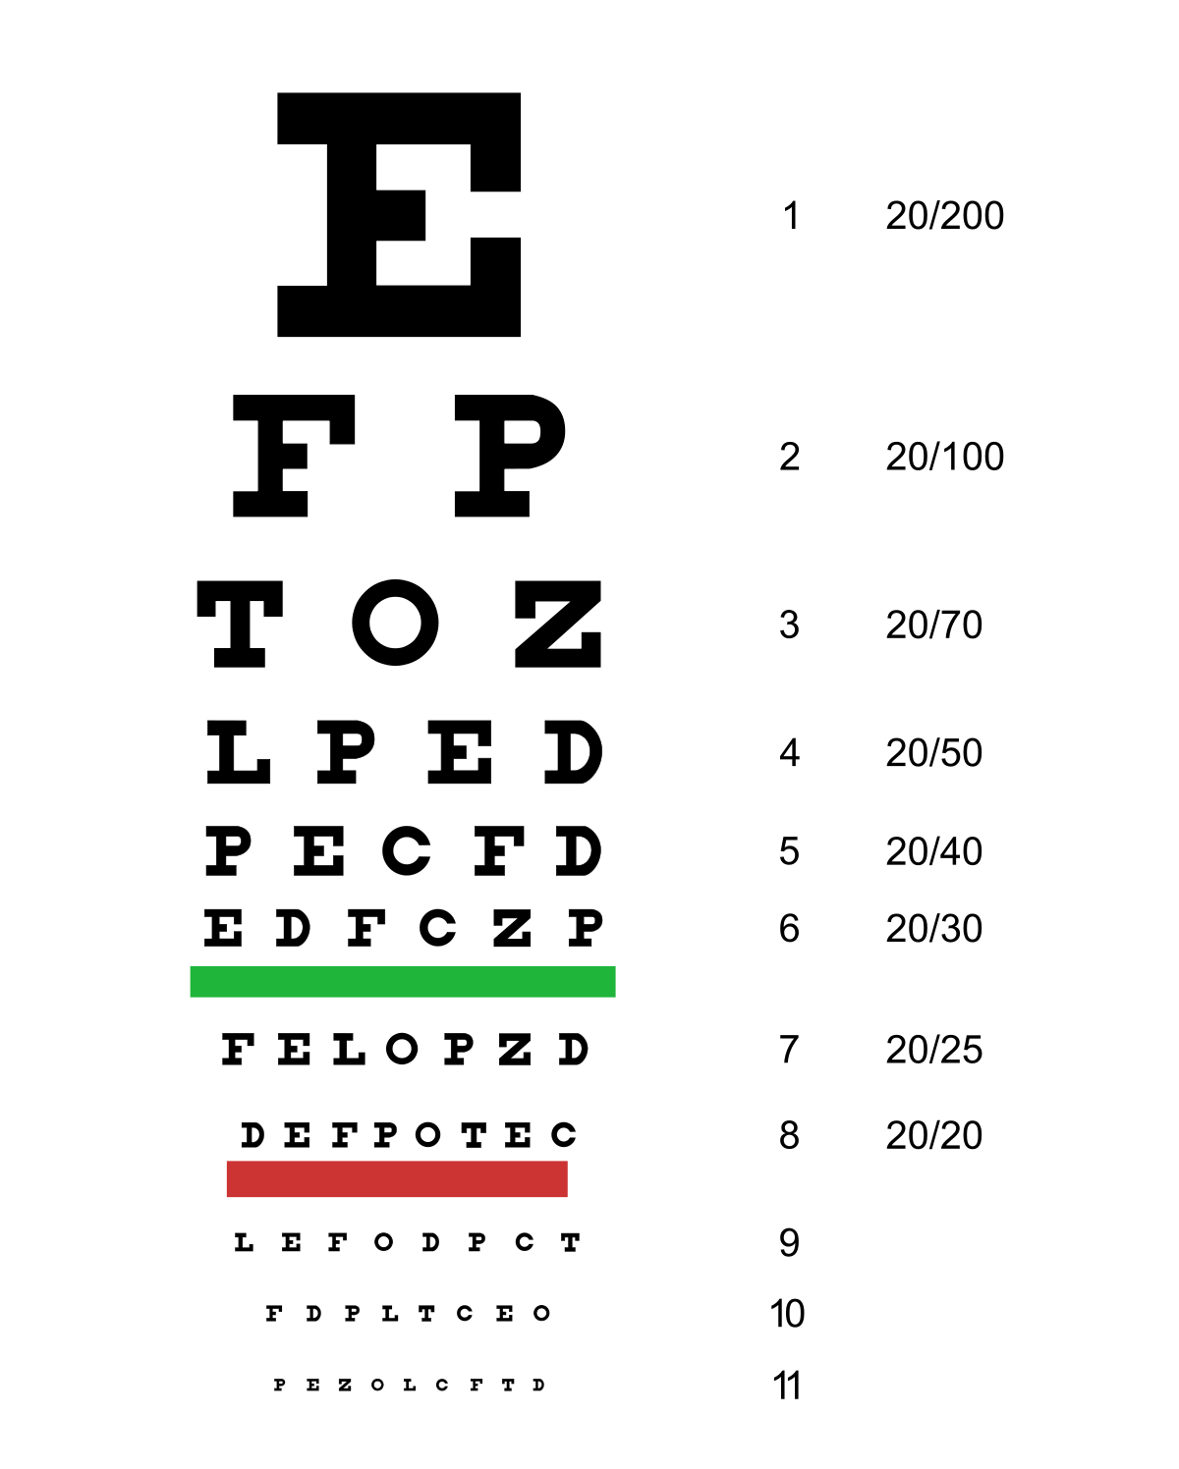
Visual Function is measured with character recognition testing (Visual Acuity testing)
The results of the Visual acuity testing does not yield consistent results for different characters sets (optotypes)
We would like to evaluate and quantify the ability to correctly identifies each of the characters used in visual acuity testing by:
Humans – we will perform an adaptive multiple choice test for each optotype
CNN – we would like to train a CNN to recognize characters in individual optotype sets or in the total opt

Slide 2






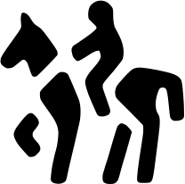



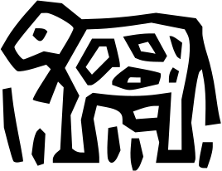
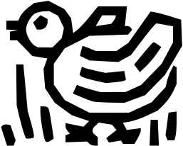







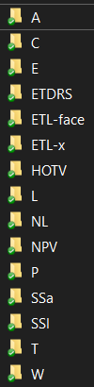

























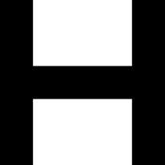





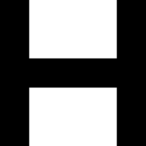



















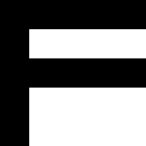



Optotype Libraries
Folder
Allen
A
Wright
W
Patti
P
Lea
L
NumLea
NL
NumPV
NPV
Landolt C
C
Tumbling E
E
HOTV
HOTV
ETDRS^{sloan}
ETDRS
To come
Snellen^{Sarrif}
SSa
Snellen^{Sloan}
SSl
ET-x
ETL-x
ETL-Face
ETL-face

Slide 3
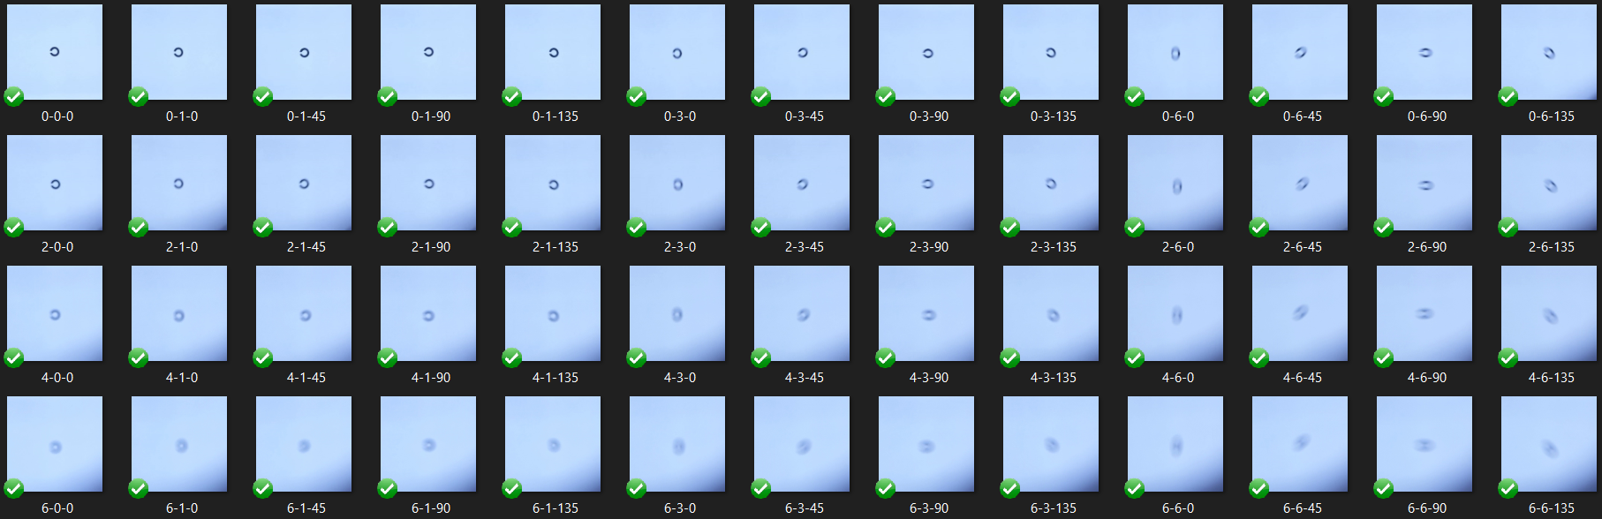

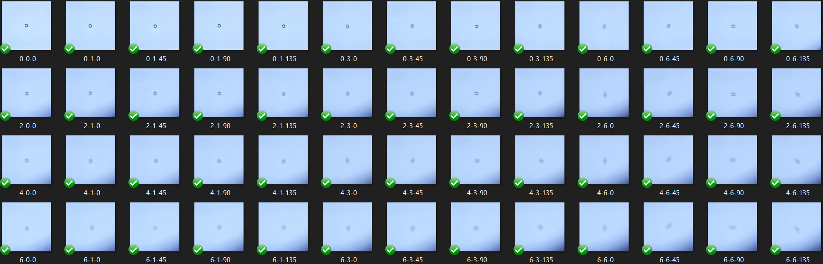

Data Acquisition
Captured images
Variable Optical Distortion
Optotype displayed on monitor
Sphere | Cyl | Axis | Spherical Equivalent | Difficulty
0 | 0 | 0 | 0 | 0
0 | 1 | 0 | 0.5 | 1
0 | 1 | 45 | 0.5 | 1
0 | 1 | 90 | 0.5 | 1
0 | 1 | 135 | 0.5 | 1
0 | 3 | 0 | 1.5 | 2
0 | 3 | 45 | 1.5 | 2
0 | 3 | 90 | 1.5 | 2
0 | 3 | 135 | 1.5 | 2
0 | 6 | 0 | 3 | 5
0 | 6 | 45 | 3 | 5
0 | 6 | 90 | 3 | 5
0 | 6 | 135 | 3 | 5
2 | 0 | 0 | 2 | 3
2 | 1 | 0 | 2.5 | 4
2 | 1 | 45 | 2.5 | 4
2 | 1 | 90 | 2.5 | 4
2 | 1 | 135 | 2.5 | 4
2 | 3 | 0 | 3.5 | 6
2 | 3 | 45 | 3.5 | 6
2 | 3 | 90 | 3.5 | 6
2 | 3 | 135 | 3.5 | 6
2 | 6 | 0 | 5 | 9
2 | 6 | 45 | 5 | 9
2 | 6 | 90 | 5 | 9
2 | 6 | 135 | 5 | 9
4 | 0 | 0 | 4 | 7
4 | 1 | 0 | 4.5 | 8
4 | 1 | 45 | 4.5 | 8
4 | 1 | 90 | 4.5 | 8
4 | 1 | 135 | 4.5 | 8
4 | 3 | 0 | 5.5 | 10
4 | 3 | 45 | 5.5 | 10
4 | 3 | 90 | 5.5 | 10
4 | 3 | 135 | 5.5 | 10
4 | 6 | 0 | 7 | 13
4 | 6 | 45 | 7 | 13
4 | 6 | 90 | 7 | 13
4 | 6 | 135 | 7 | 13
6 | 0 | 0 | 6 | 11
6 | 1 | 0 | 6.5 | 12
6 | 1 | 45 | 6.5 | 12
6 | 1 | 90 | 6.5 | 12
6 | 1 | 135 | 6.5 | 12
6 | 3 | 0 | 7.5 | 14
6 | 3 | 45 | 7.5 | 14
6 | 3 | 90 | 7.5 | 14
6 | 3 | 135 | 7.5 | 14
6 | 6 | 0 | 9 | 15
6 | 6 | 45 | 9 | 15
6 | 6 | 90 | 9 | 15
6 | 6 | 135 | 9 | 15

Slide 4
Goal
The algorithm will be trained on large characters with low optical distortion.
The algorithm will be tested on
Large characters with high optical distortion
Medium and small characters with low and high optical distortion
The algorithm must be forced to given an answer of what character it thinks is present (this may be based on a probability).
We would like to plot the probability profile for each optotypes

Slide 5
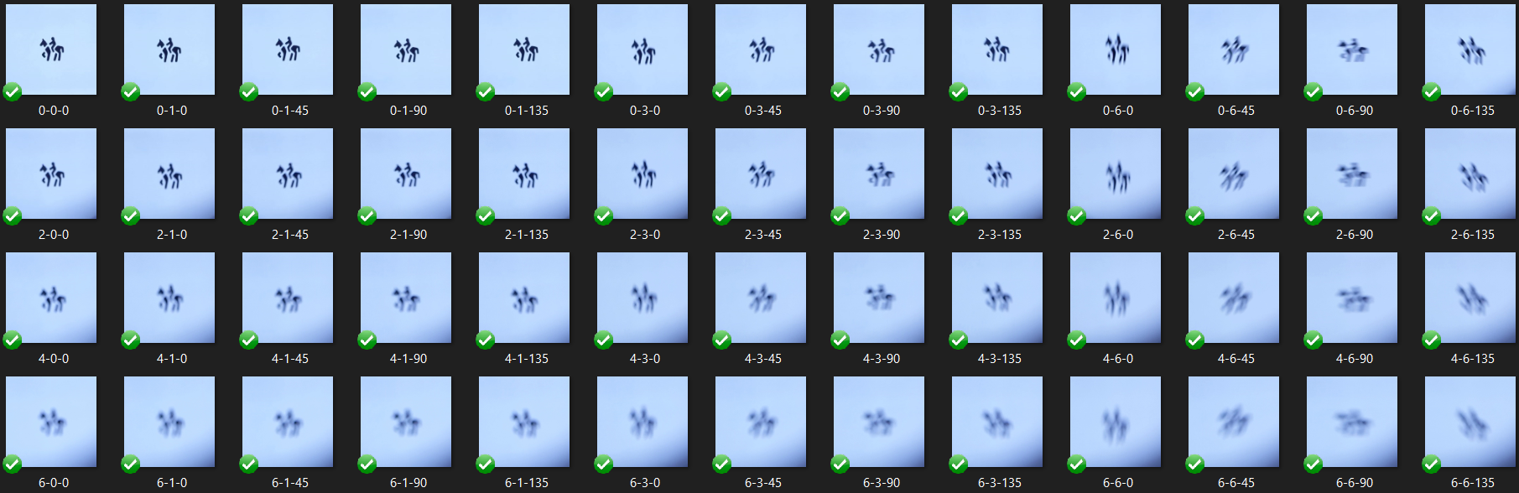
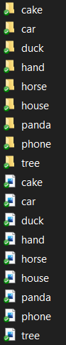
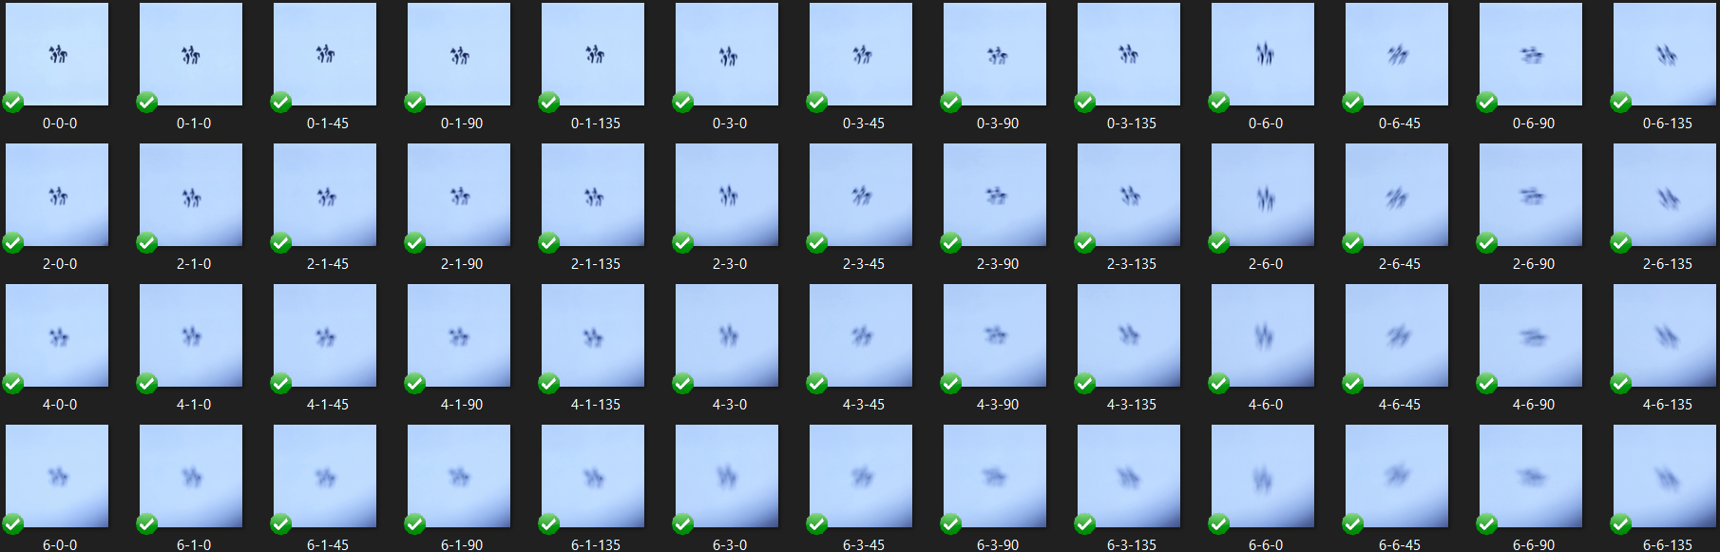
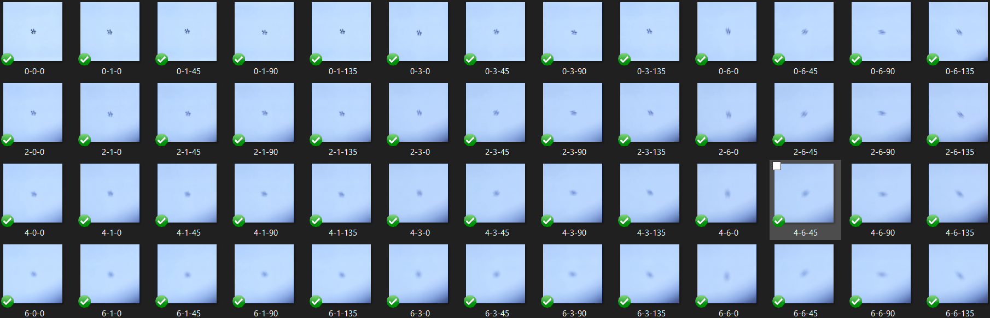
Training Set
Testing set
File Name is
Correct Answer
Algorithm determines which character it “thinks” is displayed

Slide 6
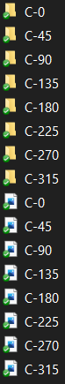
Training Set
Testing set
File Name is Correct Answer
Algorithm determines which character it “thinks” is displayed

